Slide 1


Project EAST & EVOLUTION S4Transformation Overview
SAP Solution Design & Governance
March 16, 2023

Slide 2
Program Overview
Landscape Overview
Composable Approach
Order Hub Overview
MVP Integrations
New Capabilities
Agenda
Notes:
Speaker: Charbel/Sundar

Slide 3
EVOLUTION – ESA Program Overview

Slide 4
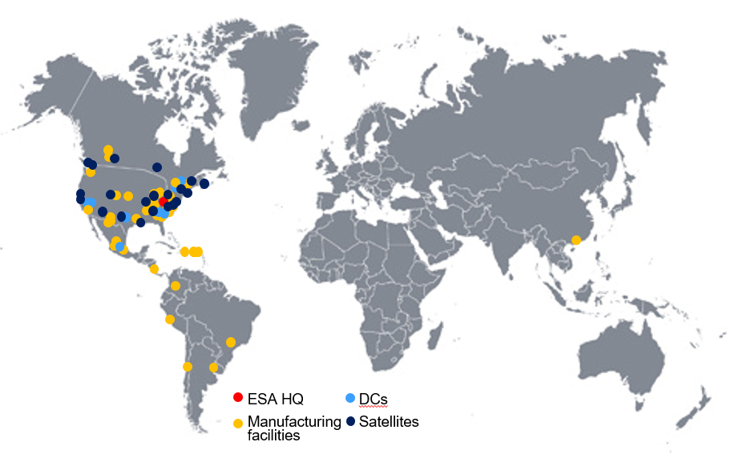


The Evolution program was initiated to modernize ES-A’s business processes and technical landscape to meet its strategic commitments.
Objective
Develop sustainable business processes and ERP systems to enable the achievement of strategic financial goals, including a 7.1% CAGR to reach $11.2B in sales, for the Electrical Sector Americas Business by 2026.
Project Scope
ES-A business leadership driving transformation
Development of consistent processes across ES-A
Includes 37 locations across ES-A utilizing Vista/Mapics/Other
Represents $5.0B in trade sales or 63% of ES-A
Accounts for 64.4% of ES-Americas profits or $871M
Impacts over 7,500 internal ERP users & 13,000 billable customers
Leverage best practices and lessons learned to mitigate risk
ES Americas by System
Oracle
All Other
Vista / Mapics
SAP ECC “Un1ty”
Vision of the Future
10% Revenue
1% Revenue
62% Revenue
27% Revenue
Integrate $3B of acquisitions faster to realize synergies
Consistently meet customer commitments
Accept one Eaton order across businesses
Utilize industry leading processes, reducing customization
Simplify user experience driving customer satisfaction
One advanced core ERP system enabling systematic growth
Best in industry edge applications increasing productivity
Business process governance to maintain consistency
Enable digital transformation
2 versions
$0.8B
5 versions
$0.1B
18 versions
$4.9B
1 version
$2.2B
1630 users
12 locations
210 users
4 locations
6015 users
33 entities
3450 users
43 entities
Partial Edge Applications
No Edge Applications
Full Edge Applications
Full Edge Applications
Scope
Notes:
Talking points: Highlight MVP approach, advisory boards, OCM investment

Slide 5




The program roadmap establishes an ERP Order Hub as the foundation, builds ERP Plant Templates for scale, and deploys in phases to mitigate risk.
2022 - 2023
2024
2024 +
Phase 1: ERP Order Hub
Establish the foundation for future plant migrations while delivering stand-alone benefits
Phase 2: ERP Plant template
Extend S/4 model to plants, base template & pilot; prove the model
Phase 3: ERP Rollout
Pilot ETO, implement localizations, scaled model and rollout
ERP Order Hub
Pilot 1.0
Pilot 2.0
Capabilities
Order management
Credit management
Global trade
Accounts receivables
Intercompany purchasing
EDI
Outcomes
Foundation of One Eaton order
Reduced price increase times
Simplified M&A integration
Insulate customers from ERP changes
Isolate plants to create deployment flexibility
Capabilities
Logistics
Manufacturing
Procurement
Warehouse management
EH&S
Made-to-Stock & Made-to-Order
Simple Engineer-to-Order (ETO)
Outcomes
Simplified user experience
Consolidated ES-A processes – governed template
Improved productivity
Detailed plant profitability
Cleveland TN Pilot
Capabilities
Complex ETO
Outcomes
Laurens & Hodges Pilot
Proven ETO model
Solution confidence
ERP Rollout
Capabilities
Services
Localizations
Outcomes
Site deployments at scale
Integrated supply chain
End-to-End visibility of inventory

Slide 6





A series of workshops were completed to design the 40 level 2 business processes that define the ERP Order Hub model
Consolidated Summary
Process Design Elements (In progress)
Key Design Decision (KDD) – is an escalated design decision due to impacts on another workstream, project, or significant organizational change
Requirements Disposition – is a categorization of requirements collected through the workshops to confirm whether they are a fit (met by standard S4HANA and industry best practice) or gap (require customization or process change) along with whether they should be included in the scope
Change Impacts - describe what is changing between the current state and future state across people, process, and technology dimensions
Process flows – depict an end-to-end visualization of future-state business processes, sub-processes, and tasks
User Story – translates requirements into individual components that team members will design, build, and test during the deliver phase
49
Total Workshops
2-4 hrs
Workshop Duration
14
Maximum Workshops per Week
12
Total Align Workshops
143 hrs
Total Design Duration
184
SMEs engaged
Notes:
Presenter: Anna

Slide 7
Segmentation Heatmap
Quote to Cash
Finance
Requisition to Check
Plan to Produce
Calculate Order Pricing Data
Capture Orders
Initiate and Monitor Contract
Collect Revenue
Manage Collections
Enable Payment
Create and Maintain Purchasing Master Data
Manage Vendor Master Data
Purchase Materials and Services
Maintain Product Related Data
Initiate, Manage and Close Partner Sales
Maintain Customer Data
Manage & Track Orders
Manage Deductions
Manage Customer Credit Exposure
Manage the General Ledger
Return to Vendor
Manage and Track Order Deliveries
Manage Contract Changes
Manage Quotations
Perform Transaction Processing
Perform Closing
Support Product Costing
Provide Customer Reporting and Audit Support
Return Order Management
Perform Down Payment Request
Cash and Liquidity Management
Report and Analyze Business Performance
Perform Customer and Product Profitability Analysis
Capability Segmentation
Perform Billing
Manage Rebates & Settlements
Manage Chargebacks
Critical to Your Business - Competitive Advantage
Customize as Required
Business Transformation Driven
Strategic
Specific to ER&I- Differentiate for Value
Adopt Leading Practices
‘Why-Not’
Driven
Core
Common Across Industries - No Differentiation
Adopt ‘Out-of-Box’ Practices
Adopt & Go
Foundational
Strategic
Core
Process
Effort
Foundational
Out of Scope for R1

Slide 8
EAST - Aerospace Program Overview

Slide 9

Aerospace has an eye towards continued future growth but is hampered by its foundational technology
Aerospace Revenue by System
75% Revenue
22% Revenue
3% Revenue
QAD MFG/Pro Legacy AERO + ITD | Oracle 11i Davenport (MSD) | Oracle R12 Orchard Park (MSD) | Avante Wimborne (MSD) | SAP ECC Legacy Cooper/IPC
3 Versions 34 Sites | 1 Version 1 Site | 1 Version 1 Site | 1 Version 1 Site | 1 Version 4 Sites
System ability to meet US DoD CMMC Level 2 requirements | CMMC
No Cannot Upgrade; Needs Replaced | No Needs Replaced | Yes | N/A Needs Replaced | Yes
Aerospace Group Headquarters
Sales & support ofﬁces
APAC Regional Headquarters
Engineering Centers
Divisional Headquarters
Eaton SAMC joint venture
Manufacturing facilities
We are unable to meet government compliance mandates, we have cyber security risk and have attained maximum value from aged (20+ year old) systems
Rapid acquisition integration is essential to synergy realization (GFSS, etc.) and require a common solution or incur interface & support costs
Our aged systems inhibit talent acquisition in today’s marketplace
Lack of global visibility prevents operational growth: centralized procurement, customer service, finance, etc.

Slide 10

The proposed solution establishes an MVP Global Template as the foundation, then adds operational capabilities and localization requirements as we rollout
Phase 1: Global Template and Initial Release
Establish the global template foundation and pilot with one US DoD site to prove model and establish solution confidence
Phase 2: Rollouts (Multiple releases)
Optimize the Global Template solution as we expand it to other sites including country specific statutory localizations and integrations to enterprise applications
Global Template
Rollout
Capabilities
ITAR compliance
Order and Credit management
Global trade
Finance and Tax integration
Intercompany purchasing
Procurement, Warehouse management, and Logistics
Operations and Engineering
Contract flow down and Program management
Aftermarket and Repairs
Outcomes
US & Rest of the World instance
Consolidated US Aero processes – governed Template
US site with US DoD Military contracts
Simplified users experience
Detailed plant and program profitability
Capabilities
Non-ITAR CTD compliance
Statutory localization
ITD and MSD divisions integration
Outcomes
French instance
Consolidated global Aero processes – governed template
Localization and site deployments
Integrated supply chain
Sustainment and benefits realization
10
Notes:
Presenter: Fred
Release 1 – deliver Order Hub proof of concept for targeted customer group
2023 is focused on planning, design, build & test and OCM
2023 is focused on build & test, validation, training & deployment
Plant engagement – site teams engaged (Jan), testing (Jan-Jun), training & readiness assessment (Jun-Jul)

Slide 11
Imagine Phase – At a Glance
Consolidated Summary
Process Design Elements
Participants in Imagine workshop sessions
Key Design Decisions logged
Key Design Decision (KDD) – is an escalated design decision due to impacts on another workstream, project, or significant organizational change
Requirements Disposition – is a categorization of requirements collected through the workshops to confirm whether they are a fit (met by standard S4HANA and industry best practice) or gap (require customization or process change) along with whether they should be included in the scope
Change Impacts - describe what is changing between the current state and future state across people, process, and technology dimensions
Process flows – depict an end-to-end visualization of future-state business processes, sub-processes, and tasks
User Story – translates requirements into individual components that team members will design, build, and test during the deliver phase
390+
500+
1900+
User stories have been drafted
SMEs participated in the Imagine Phase
148+
Gaps identified
75
Workshops completed to date
364
120
L2 Processes
1800+
Requirements logged across all process teams
Notes:
Presenter: Anna

Slide 12
Capability Segmentation Heatmap
Aftermarket
Finance
Program Management
Plan to Produce
C-010: Installed Base Management
C-040: Process Transactions and Inquiries
C-050: Evaluate Initial Service Call
DC-010 Perform Transactional Processing
DC-020 Manage the General Ledger
DC-030 Perform Closing
MP-020 Determine Projects
MP-030 Develop Initial Project Plan
MP-060 Develop Detailed Project Plan
M-060
Perform Long Range Production Planning
M-070
Perform Medium Range Production Planning
M-080
Perform Short Range Production Planning
C-060: Execute Field Service
C-080: Perform Product Induction
C-090: Plan Component Maintenance
DC-040 Perform Fixed Asset Accounting
DC-050 Perform Project Accounting
DC-070 Perform Fixed Asset Additions
MP-070 Analyze Project Feasibility
MP-080 Obtain Project Approval
MP-090 Manage Project Budgets & Funding
M-090
Schedule Production
M-100
Execute Production
M-150
Maintain Product Related Data
C-100: Execute Internal Component Repair
C-110: Execute External Non-Direct Repair (Subc)
C-120: Exchanges and Loans
DC-080 Perform Fixed Asset Depreciation
DC-090 Perform Fixed Asset Transfer
DS-010 Perform Overhead Accounting
MP-100 Prepare and Schedule Project for Execution
MP-110 Execute Project
MP-120
Manage Start Up & Commissioning
M-130
Perform Quality Management
M-140
Manage Product Disposition
M-200
Implement Change Order
C-130: Execute Scrap
C-150: Manage Warranties
C-190: Manage Recalls
DS-020 Support Product Costing
DC-030 Support Customer Profitability Analysis
DC-040 Report & Analyze Business Performance
MP130 Track and ‘Close Project
M-160
Maintain Product Related Data
M-170
Control and Report Production Operations
P-140
Determine Discrepant Material Disposition
C-230: Plan Work Arising
C-240: Manage Configuration
C-250: Provide Customer Training
P-130
Perform Incoming Quality Assurance
EHS-030
Substance Volume Tracking
EHS-040
Dangerous Goods Management
C-270: Provide Spare Parts Support
C-300: Maintain Service BOM
C-320: Manage Surplus
A-020: Service Parts Demand Management
A-030: Service Parts Supply Planning
O-130: Return Order Management
Strategic
Core
Foundational
Out of Scope
Notes:
Speaker: Alicia

Slide 13
Capability Segmentation Heatmap
Quote to Cash
Requisition to Check
O-040A
Calculate Order Pricing Data
O-020
Process Orders
N-010
Initiate and Monitor Contract
GT-180
Manage Global Trade Master Data
P-220
Manage Vendor Master Data
P-230
Create and Maintain Purchasing Master Data
P-050
Strategic Sourcing Materials & Services
P-145
Return to Vendor
EW-010
Inbound Process- Inbound Notification & Planning
S-230
Initiate, Manage and Close Partner Sales
O-030
Maintain Customer Data
O-040
Manage & Track Orders Deliveries
GT-020
Product Classification
P-060
Manage Procurement Contracts & RFQs
P-090
Monitor and Manage Supplier Contracts
P-070
Create and Maintain Purchase Requisitions
P-110
Procure Subcontracting
EW-040
Inbound Process- Post GR & Product Destination Determination
O-040
Manage and Track Order
N-050
Manage Contract Changes
O-330
Manage Quotations
GT-030
Compliance Screening
P-080
Purchase Materials and Services
P-240: Create and Maintain Purchase Requisitions (Indirect Material)
P-250: Purchase Indirect material and Services
M-190
Manage Subcontracting
EW-060
Inbound Process- Put Away Product
N-040
Provide Customer support and Audit requirement
S-170
Initiate and Mange and Close Internet Sales
N-025
Perform Down Payment Request
GT-090
Manage Trade Preference
P-040
Maintain Supplier Certification & Monitor Performance
P-200
Manage Procurement from Small & Minority Owned Businesses
L-170
Intercompany Stock Transport Order (STO)
I-100
Manage Supplier Consignment Stock
EW-110 Inventory Control- Replenishment
N-020
Perform Billing
S-190
Manage and Evaluate Sales Performance
O-080
Perform Compliance and customer Acceptance
GT-050
File Import and Export Transaction
EW-070
Inventory Control- Ad Hoc Warehouse
EW-080 Inventory Control- Manage Scrap
EW-100 Inventory Control- Manage Inventory Cont.
L-110
Manage Lots/Batches & Serial No.D19
EW-170 Outbound Process- Picking
O-100
Process Spare Order
O-120
Manage Backorders
O-320
Manage Inquiries
GT-100: Intrastat Report
EW-180 Outbound Process- Packing
L-160
Manage Logistics Performance
EW-190 Outbound Process- Ship/Deliver Orders
Initiate and Monitor Scheduling Agreement
S-240
Develop Sales Forecast
GT-110
Global Trade Reporting
Strategic
Core
Foundational
Out of Scope
Notes:
Speaker: Alicia

Slide 14
Landscape Overview

Slide 15
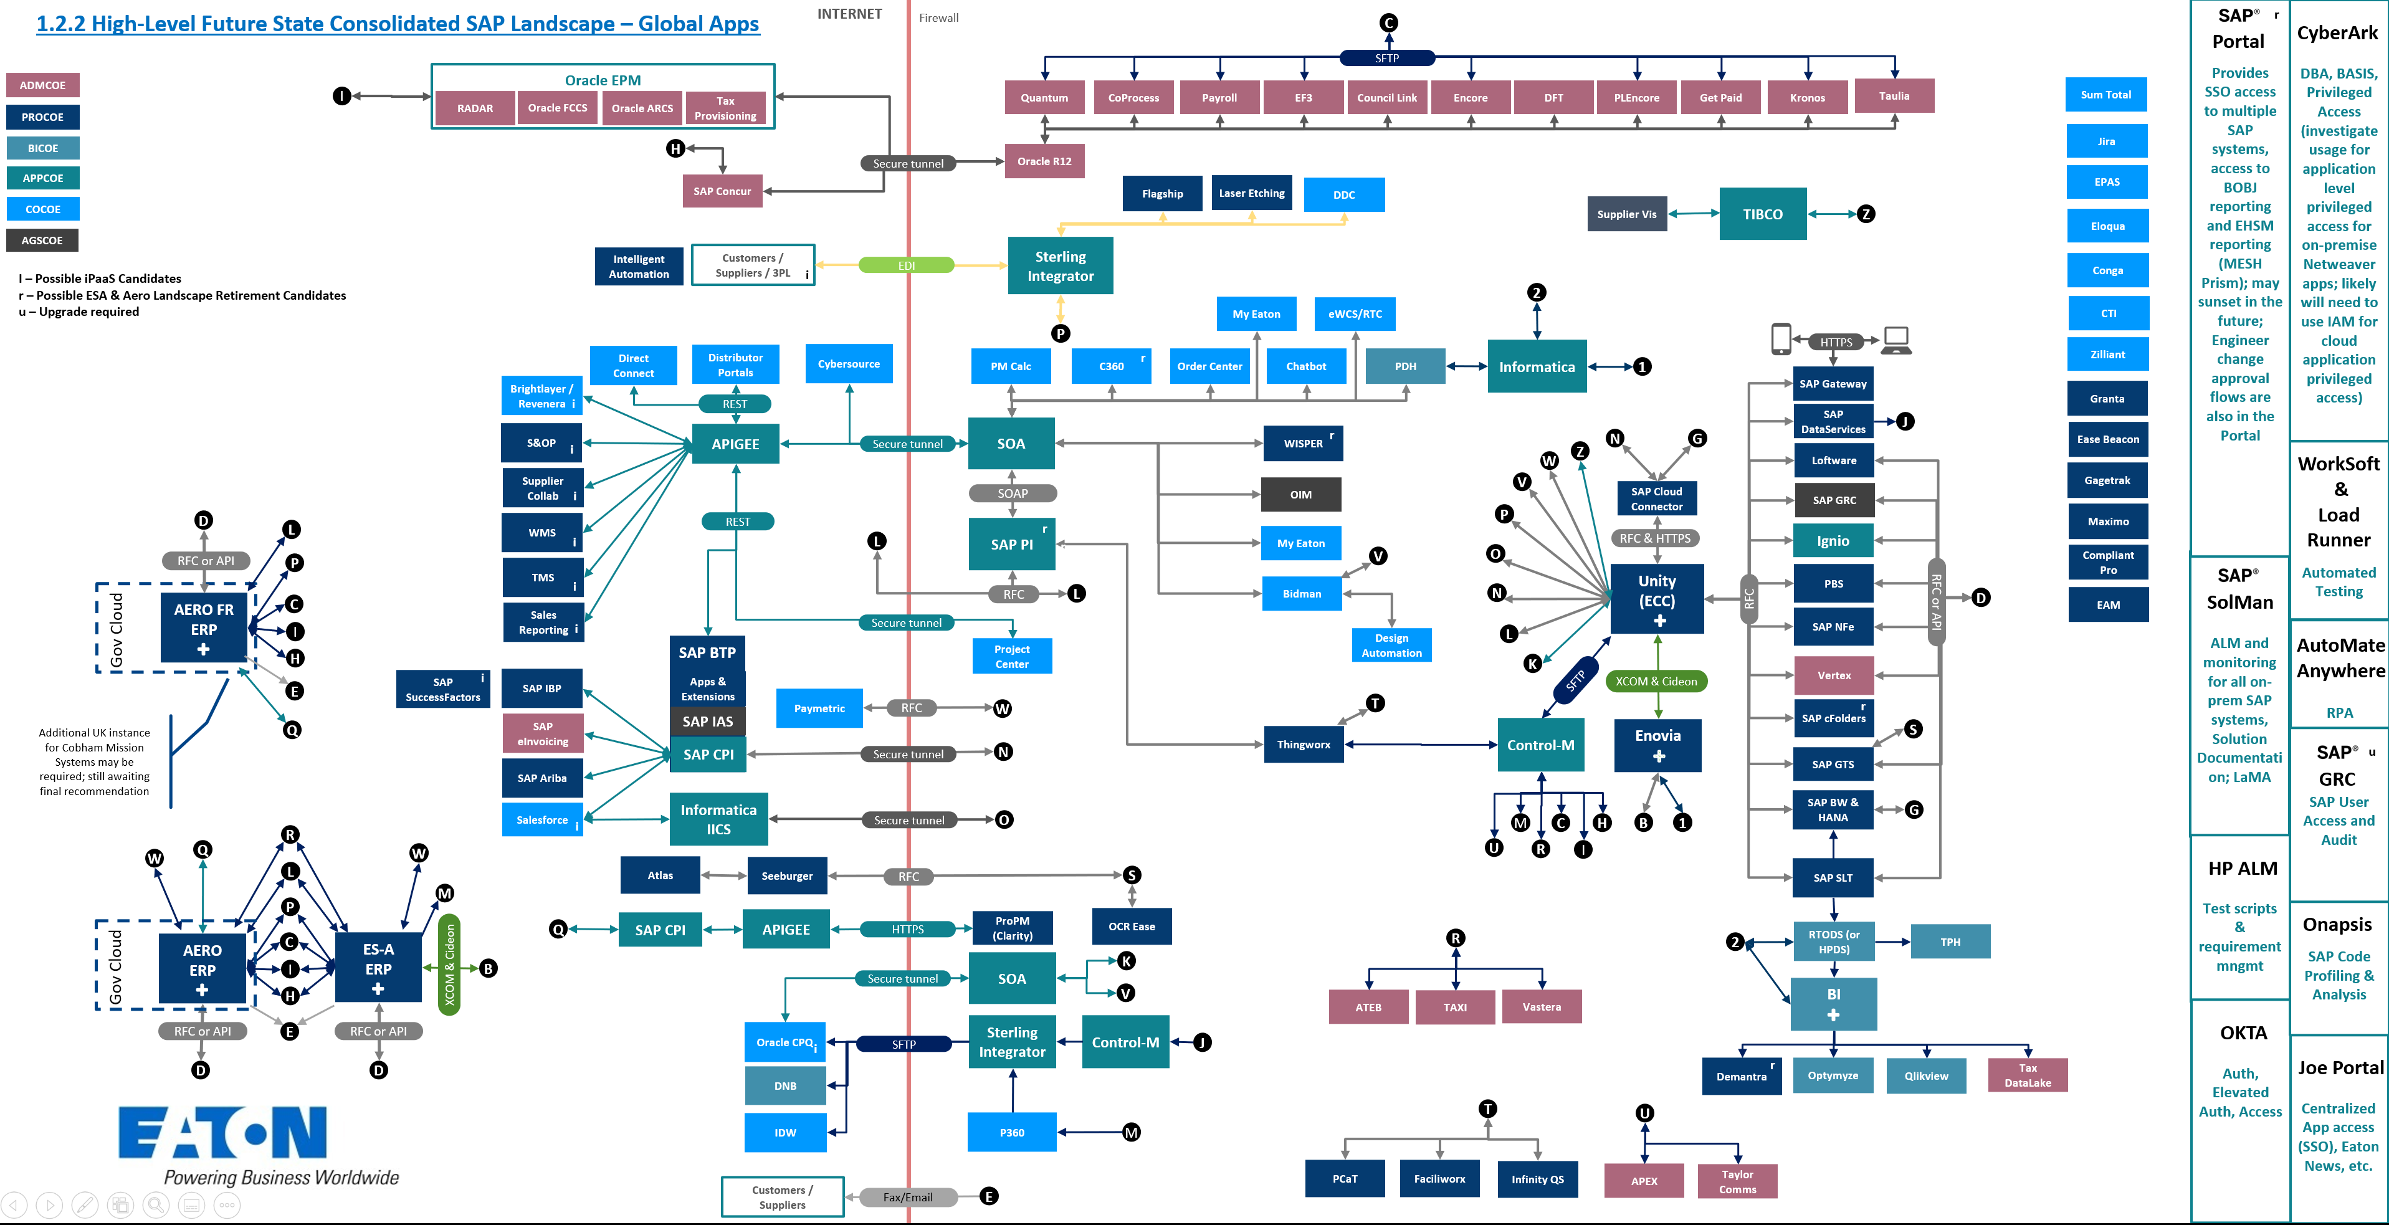
1.2.2 To-Be Landscape
HIGH LEVEL FUTURE STATE CONSOLIDATED SAP LANDSCAPE – GLOBAL APPS
RISE
NS2

Slide 16
High-Level Client Strategy
Sandbox
Development
QA
Prod
Client | Type
100 | Explore
200 | Explore
Client | Type
100 | Configuration
200 | Unit Test
355 | Data Load Test
500 | Variant Configuration
Client | Type
100 | Unit Test / Test
355 | Data Load Test
Client | Type
100 | Production
16

Slide 17
Cloud Hosted Environments
ESA is hosted in SAP RISE
Multitenant cloud
Azure EAST
Not suitable for ITAR / CUI organizations
Aero is hosted in SAP NS2
NS2 working towards CMMC level 3 compliance
Tightly regulated, adding a new integration / end point requires a ticket with NS2 that takes up to seven days to enable and requires multiple teams to properly identify
17

Slide 18
Composable Approach

Slide 19






























The target composable architecture enables faster time to value through best-in-class edge solutions and simplified integration with a clean, standard ERP core.
1
Enabling faster time to value through a cloud first approach and composable architecture guiding principles
Modularity to use best-in-class edge solutions and capabilities
Simplified integration through API and micro-service focused strategy; ERP enhancements & extensions moved outside of the core & into the application composition layer
Clean, standard ERP core to increase agility, reduce complexity and reduce costs
Product
Lifecycle
Management
Marketing
& Lead
Management
Demand
Forecast &
Planning
Customer
Relationship
Management
Quality
Service
Scheduling
Compliance
& GTM
Plant
Maintenance
Design
Incentive
Management
Supply
Planning &
Collaboration
Install Base
Management
eCommerce
Equipment
Monitoring
Mobile
Services
Strategic
Sourcing
Digital
Manufacturing
Portfolio
Management
Configure
Price & Quote
Service
Management
Smart Tools
& Subscription
Management
Warehouse
Management
Others…
Others…
Others…
Others…
Others…
Engineering
Lead to Order
Supply Chain
Manufacturing
Field Service
2
Application Composition Layer
Integration | Composition | Orchestration | Development | UX Development | Enterprise Messaging | AI/ML | IoT
Reporting &
Consolidation
Fiori
Treasury
3
Data Layer
Source Data | Metadata | Rationalization | Change Data Capture| Federated Datawarehouse | MDM
AP / AR
Order
Management
& Billing
Lean
Warehouse
Management
Finance
& Controlling
Tax
Others…
Travel &
Expense
Production
Quality
Management
Environment
Health & Safety
Logistics
Management
Others…
Reporting
Visualization | Self Service | Analytics
Others…
Others…
Finance

Slide 20
ESA Order Hub Overview

Slide 21






New capability
Order Hub Overview
CSR
Significant impact to existing capability
Customer
Existing capability
Finance
~54% of revenue & 61% of lines through EDI
~30% of revenue & ~25% of lines are entered manually
Simplifies order entry for the customer
Adds new microservices & APIs; also defines sales and I/C packaged business capabilities (PCBs)
Leverages & improves existing intercompany transaction processes
Enables rapid edge deployment for sales processes through reduced integration complexity
Standardizes order management, order entry, & I/C purchasing for the operational backbone
ERP
EDI
Mapping &
Processing
Credit
Management
EDI
EDI
Logistics
Management
Order
Management
Billing
Customer
Invoiced
Sourcing
Strategy
Management
Order
Capture
EiPaaS
Availability
To Promise
Intercompany
AR & AP
Customer
Order
Entry
Credit
Card Payment
Order
Entry
Intercompany
Purchasing
Product
Content
Management
API
API
Routing
API
FILE
Others…
CoProcess
Vista
MAPICS / WM
~16% of revenue & ~14% of lines are entered through Order Center
eCommerce
Integration
Availability
To Promise
Netting
EDI
API
Order
Management
Logistics
Management
Unify
Configure
Price &
Quote
EDI
FILE
MDM
EDI
ETO
Data Layer
Billing
EDI
Intercompany
AR
Data translation APIs
21
Notes:
Presenter: Chris
Solving for:
Single customer order
Centralized credit management for ES-A
Improved I/C processing, currently operating largely on a day lag, moving towards more real time processing
We do this today in some capacity through EDI, but the processes are not standardized across the electrical sector and the order entry in the target environment can take up to a day depending on the EDI setup. We’d like to improve these processes and switch to more real-time integrations. Ideally this will be done with a tool like an iPaaS for the API / microservice mapping; however, we can accomplish this with the tools we have in place today.

Slide 22
MVP Integrations

Slide 23
ESA MVP Integrations and Addons
23

Slide 24
Aerospace MVP Integrations and Addons
24

Slide 25
New Capabilities

Slide 26
Planned Implementation of Key New Capabilities
Advanced ATP
Supply Protection
Product Allocation
Production Planning and Detailed Scheduling
Embedded Analytics
Virtual Data Model and CDS Views
Enable Now
26

